Slide 1
Computer Science and Data Analytics
Prof Regina Berretta
School of Electrical Engineering and Computing
The University of Newcastle
https://www.newcastle.edu.au/profile/regina-berretta

Slide 2
Computer Science
Computer Science is all about problem solving using computers
Computer Science’s main focus is designing and implementing algorithms to solve problems.

Slide 3
Computer Science – Some applications
Science & Engineering
Climate Science Models, Computational Fluid Dynamics
Software Development
Google, Microsoft, IBM
Manufacturing
Logistics, Automation
Entertainment
Video Games, CGI, Netflix
Health
Computer Aided Diagnosis, Electronic Health Records
Business
Business analytics

Slide 4
Computer Science – Some fields
Artificial Intelligence and Robotics
(movies: Bicentennial Man, Robocop, Ex Machina)
Computer Graphics
(Pixar, DreamWorld movies)
Cryptography
(movie: The Imitation Game)
Bioinformatics (or computational biology)
GATACA
Data analytics
(Money Ball, Margin Call, 21)

Slide 5
A lot of data is generated everyday, everywhere
Social network
Biological data
Financial transactions
Online trading
Climate
Traffic
Sports
…

Slide 6
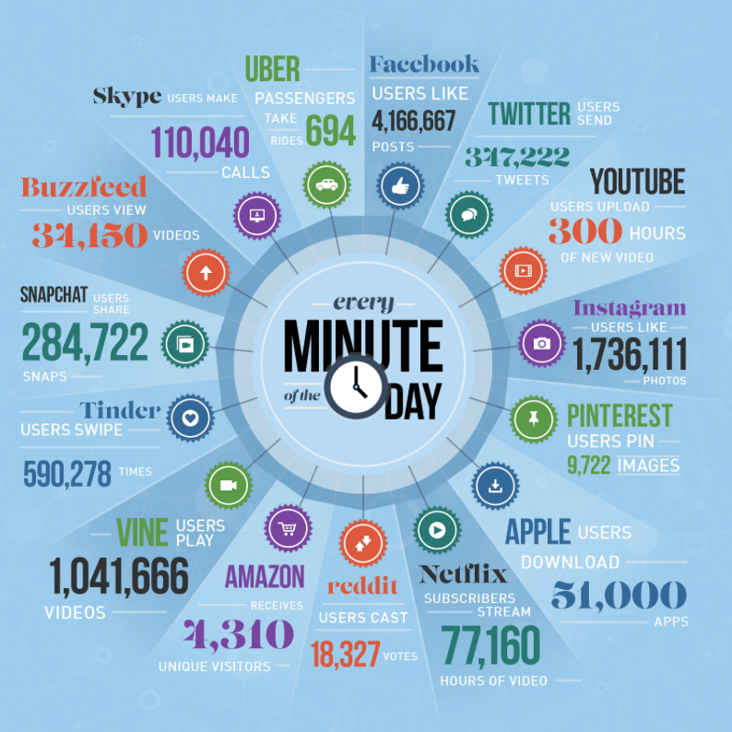
Data generated by minute in social media
Analyze these data can bring valuable information, as
Social groups with similar interests.
Groups of companies sharing a market.

Slide 7
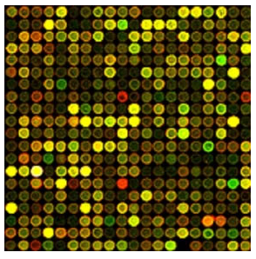
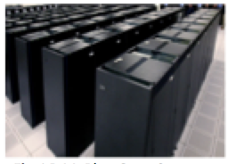
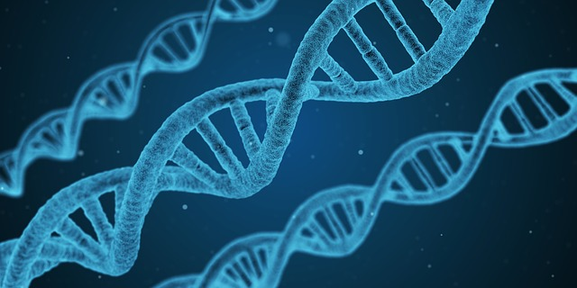
Biological data – genetic information
Cancer is an incredibly complex disease
Genetic information from people with cancer can help to find patterns that help to understand the disease

Slide 8
Challenges
How to store?
How to organise?
How to analyse?
How to extract knowledge from it?
There are several different expertise/techniques (from statistics, mathematics and computer science) to answer each of these questions
Let’s see an example called community detection

Slide 9
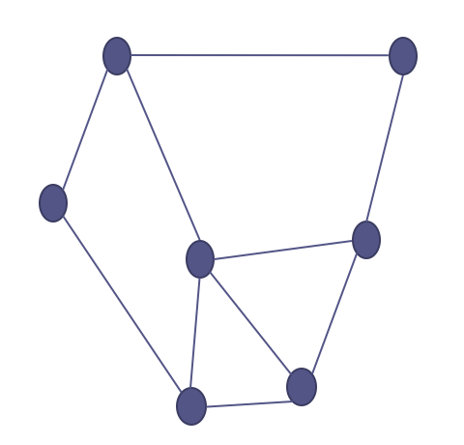
Networks and graphs
A network can be represented by a graph, a set of nodes joined by edges.

Slide 10
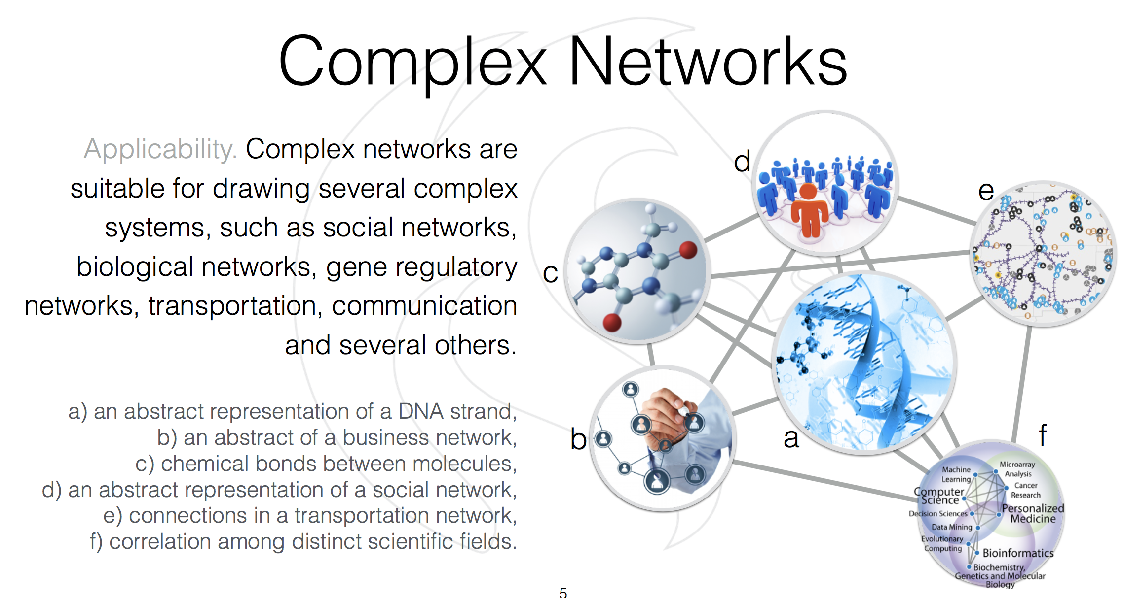

Slide 11
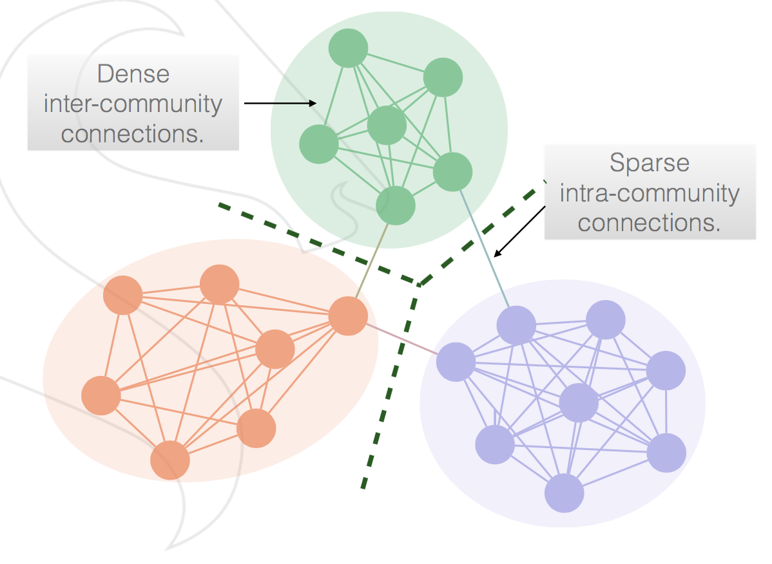
Communities in networks
Groups of nodes densely connected among its members and sparsely connected to rest of the network.
Social groups with similar interests.
Groups of proteins or genes related to a disease.
Groups of companies sharing a market.
Web sites linked to one another
Let’s see an example using Twitter

Slide 12
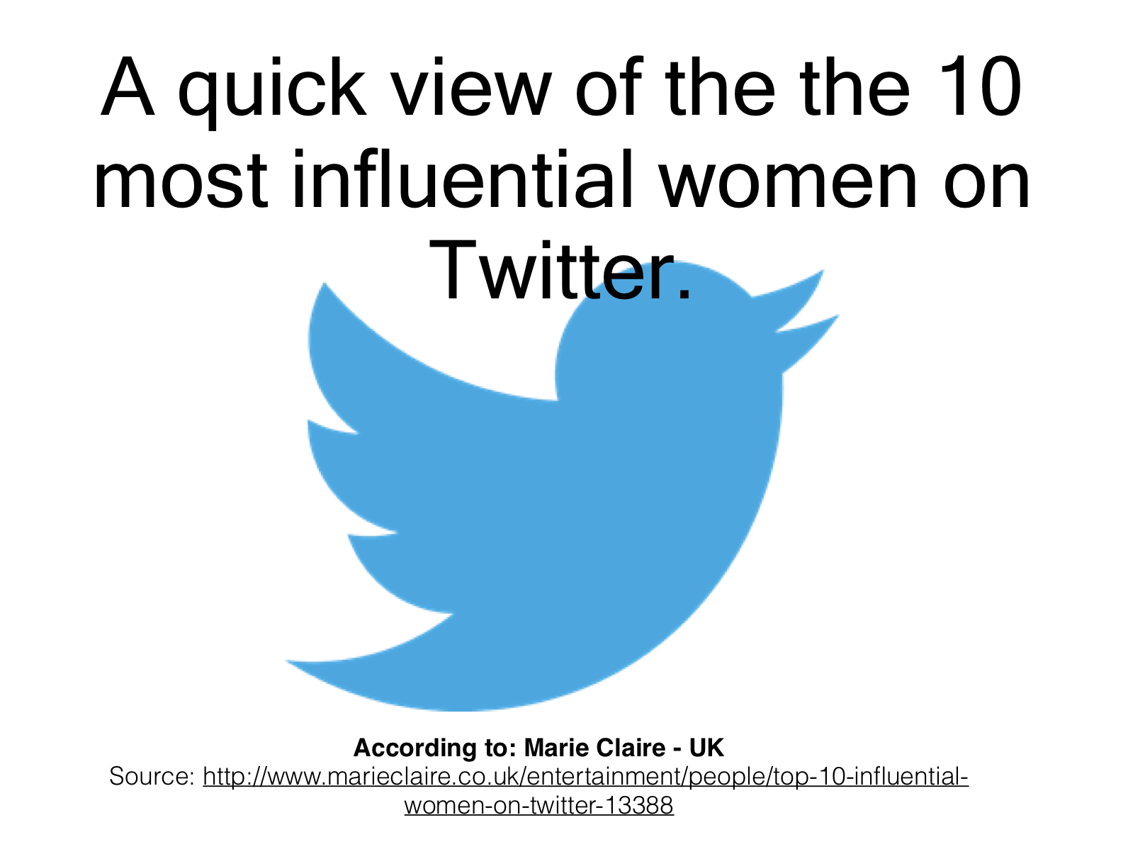

Slide 13
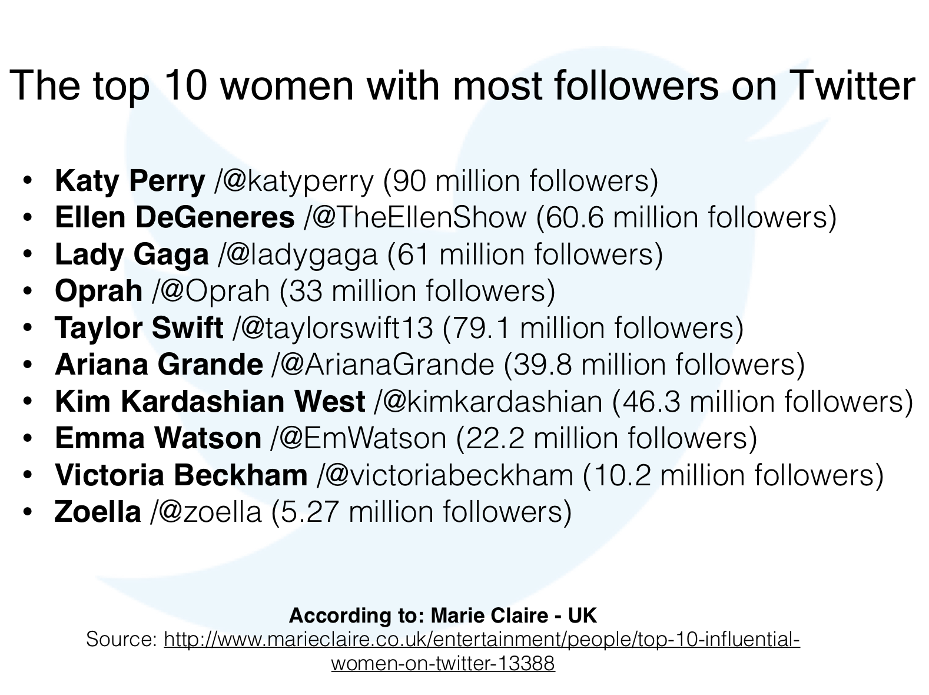
Small example

Slide 14
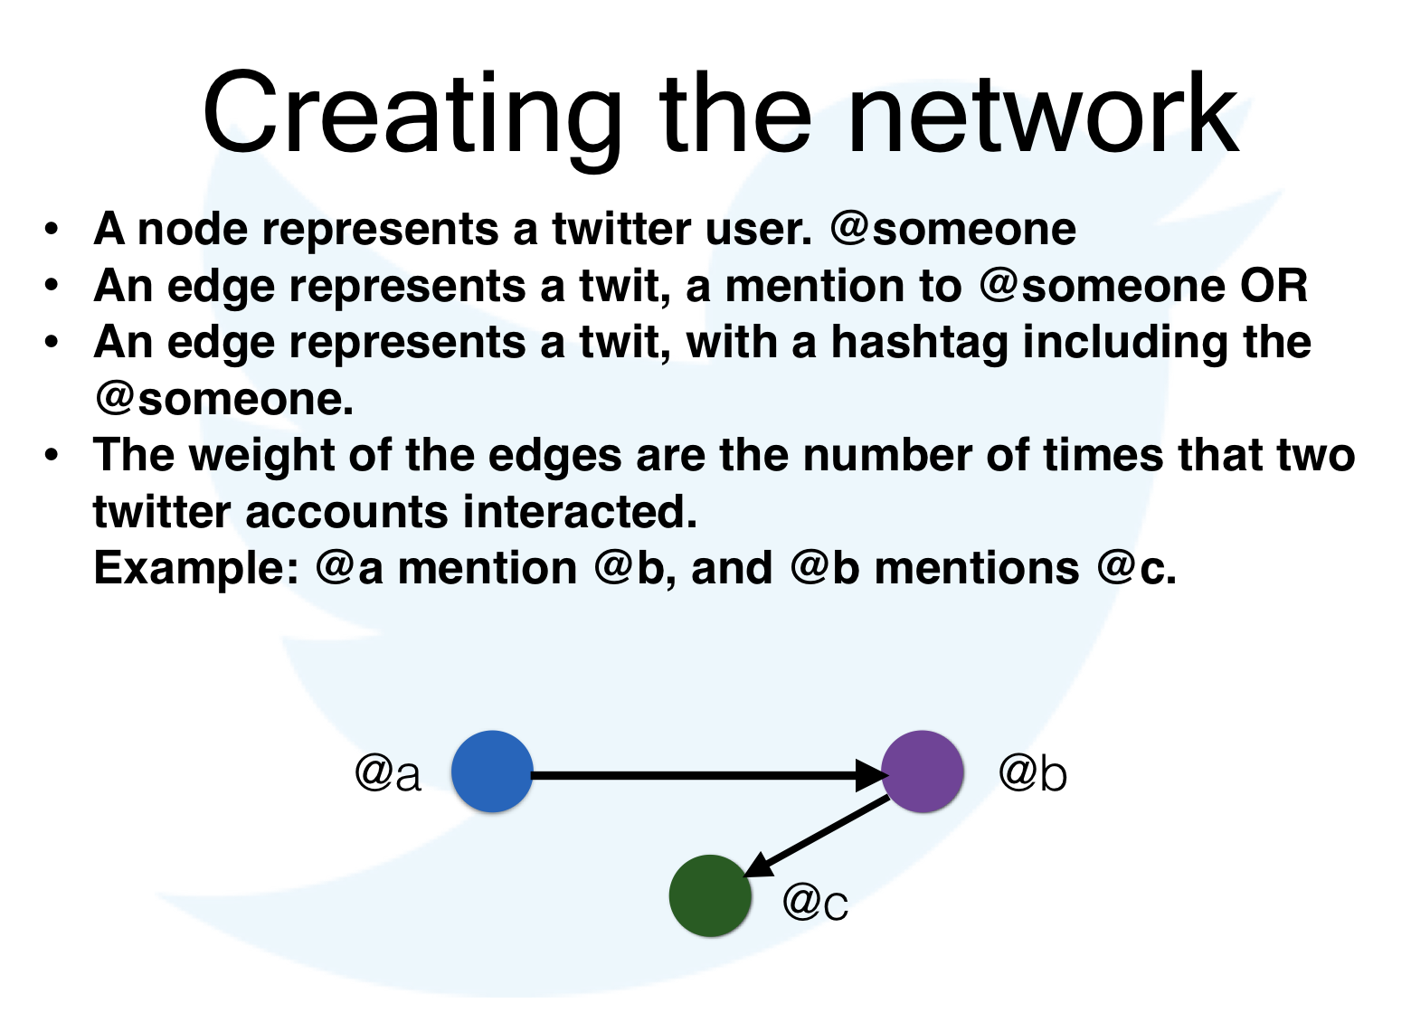

Slide 15
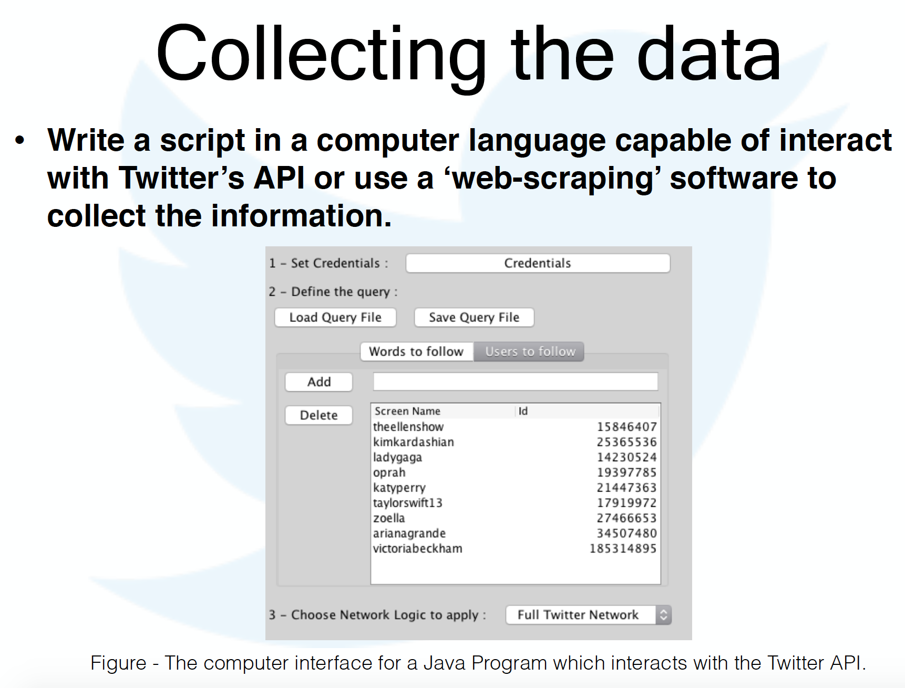

Slide 16
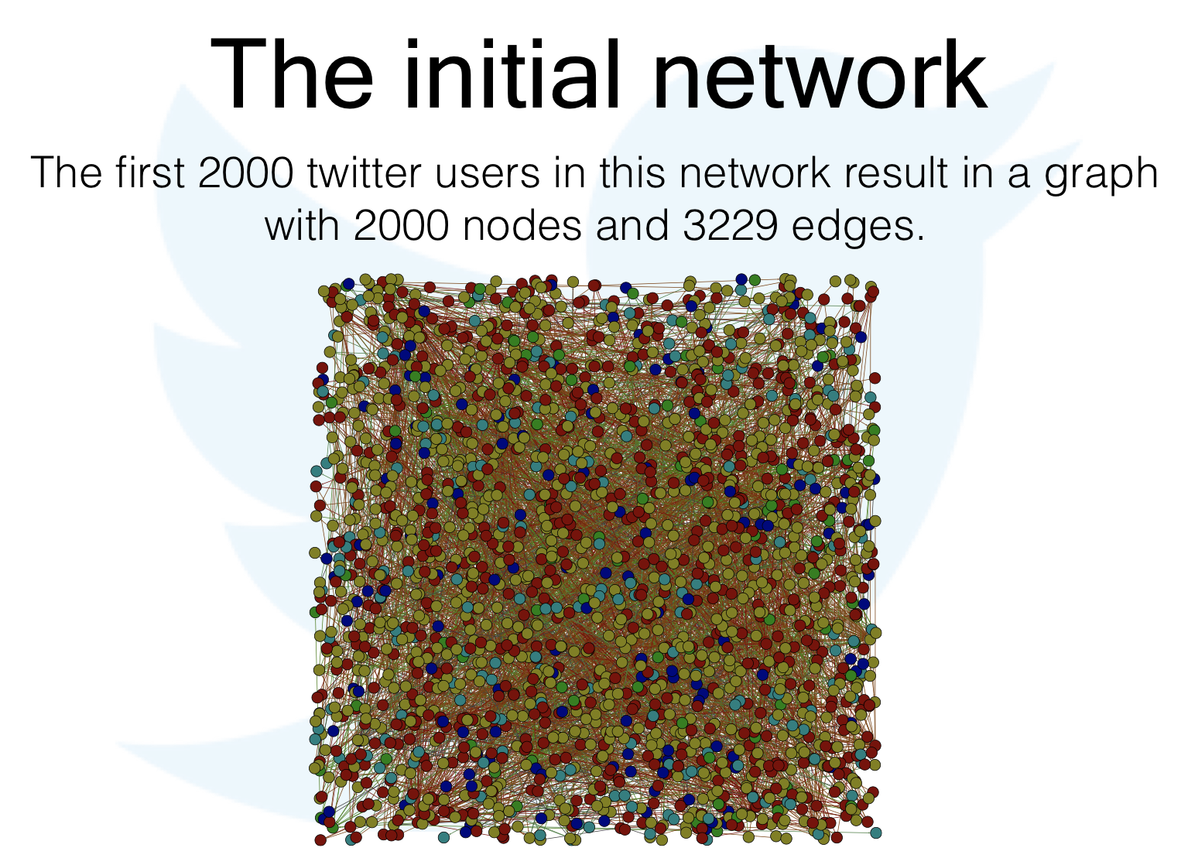

Slide 17
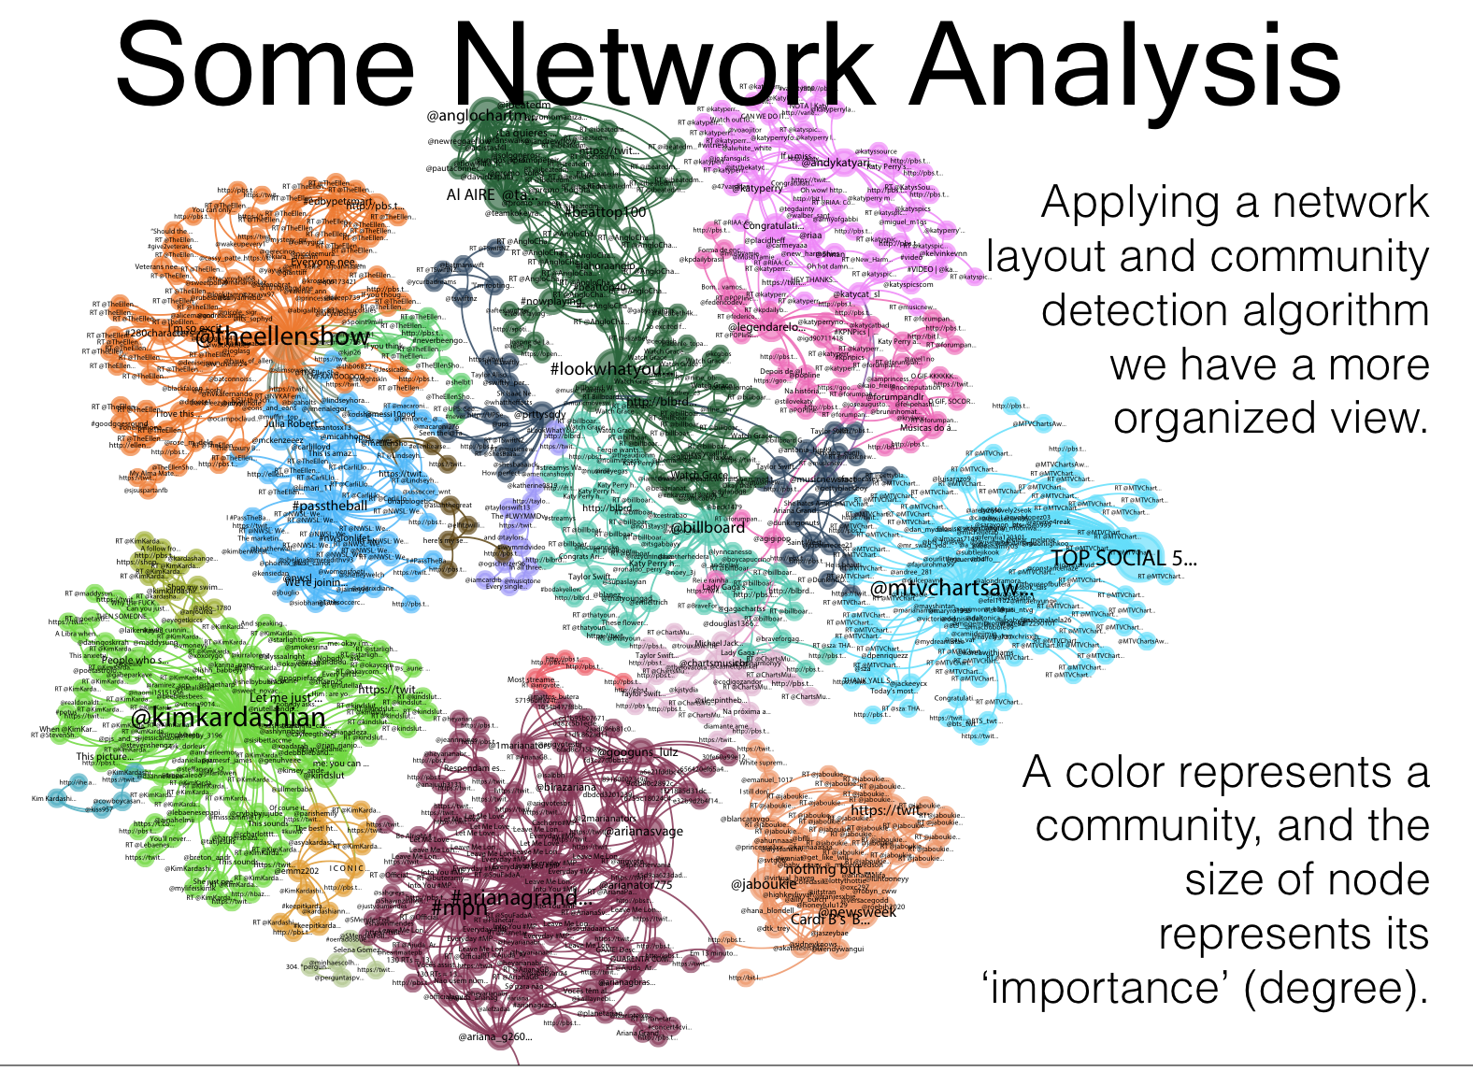

Slide 18
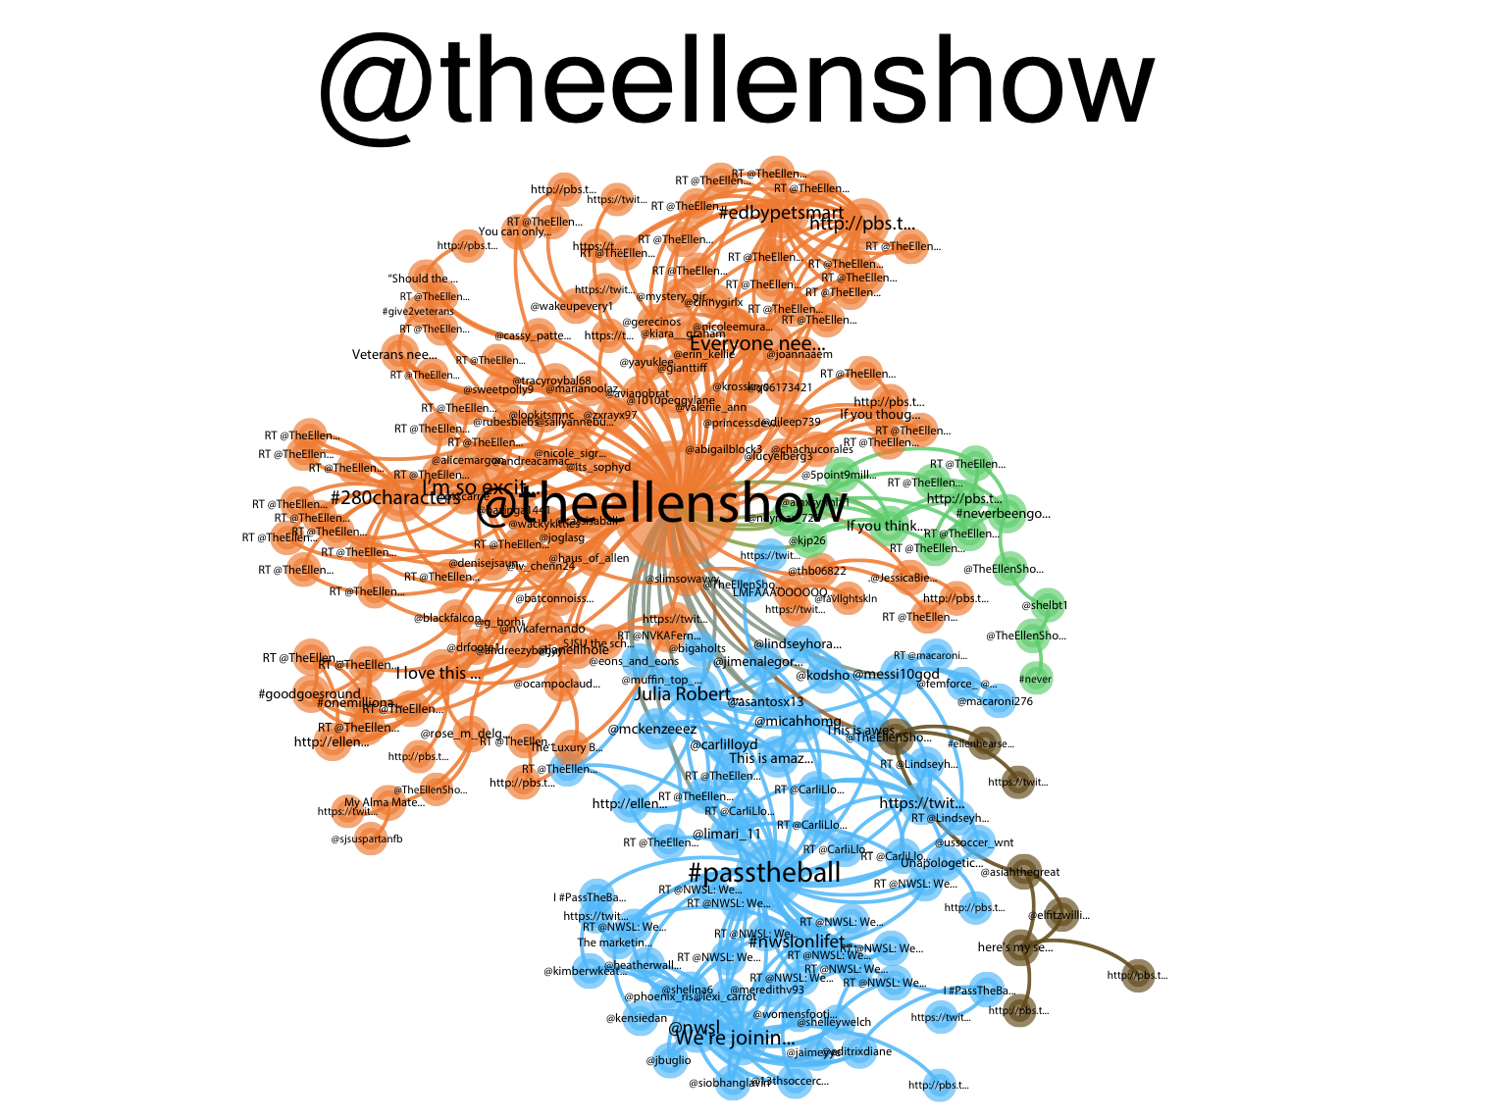

Slide 19
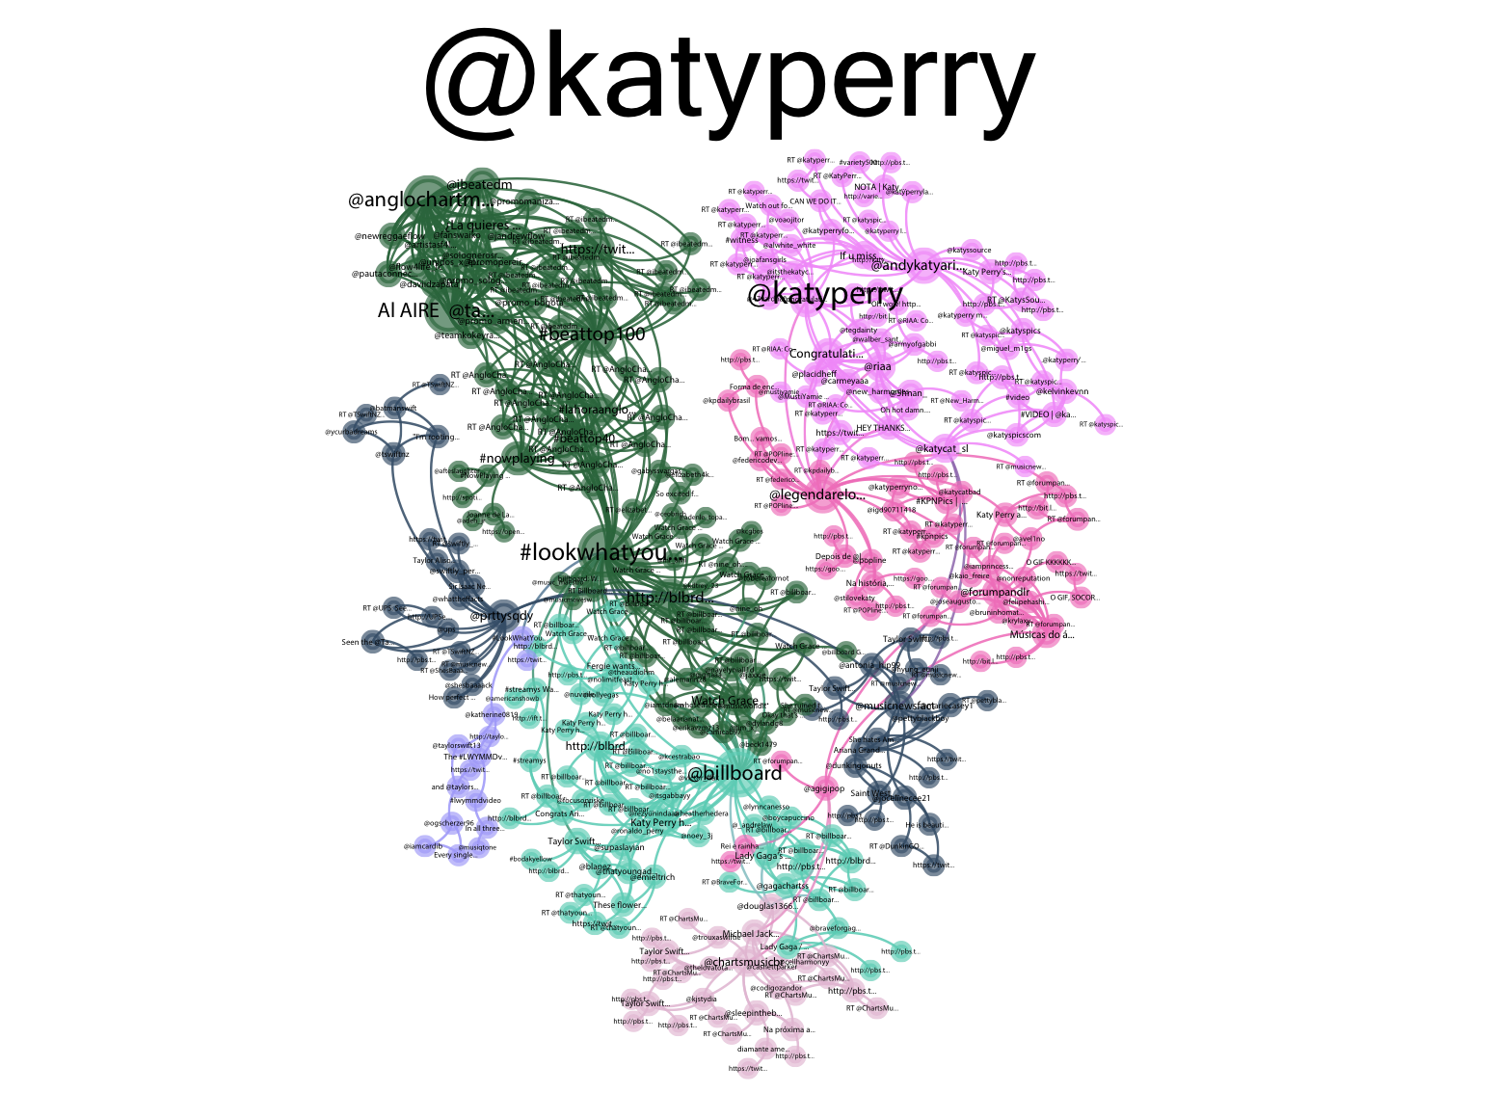

Slide 20
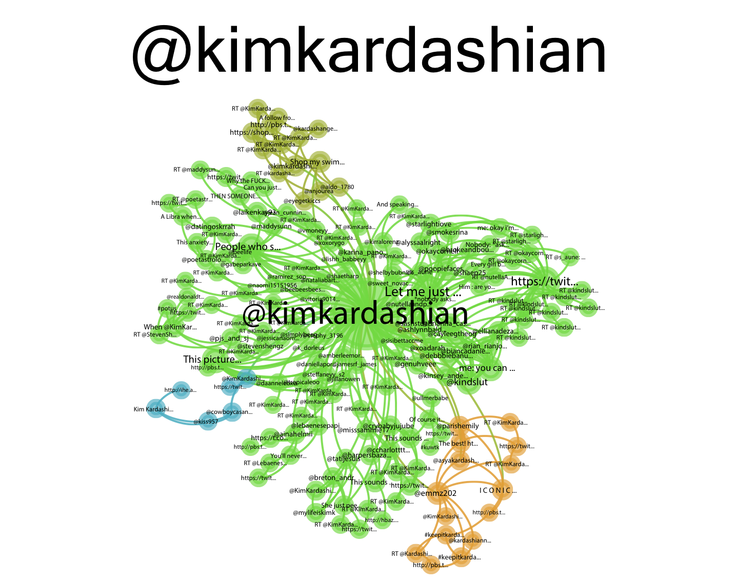

Slide 21
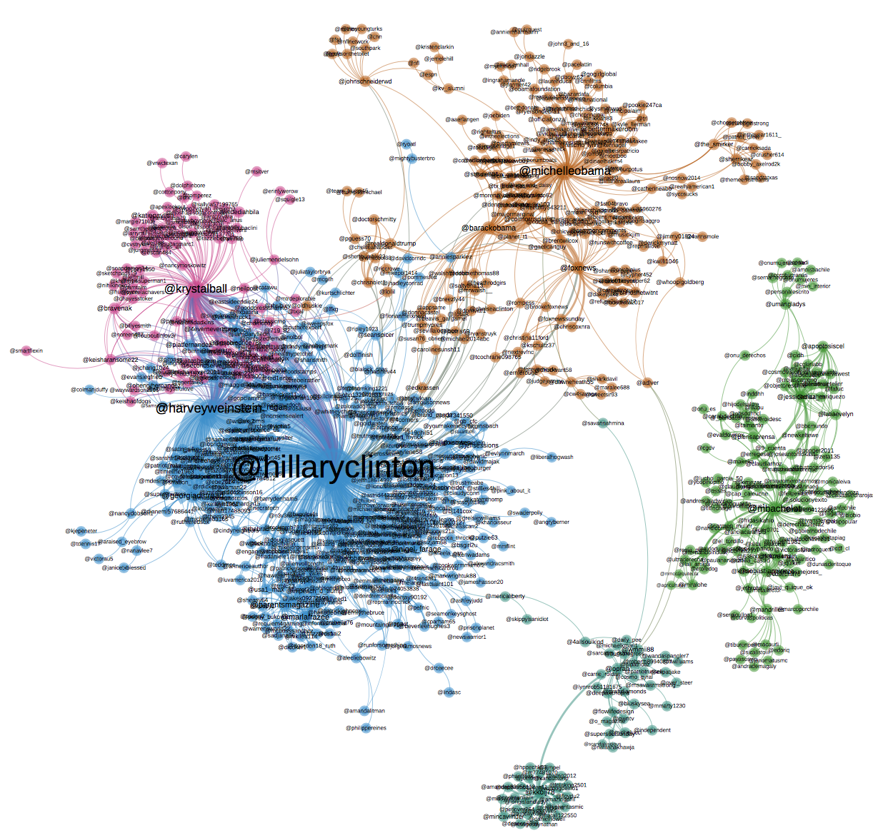
Another example
Twitter data from the first 25 most powerful women according to Forbes. https://www.forbes.com/power-women/

Slide 22
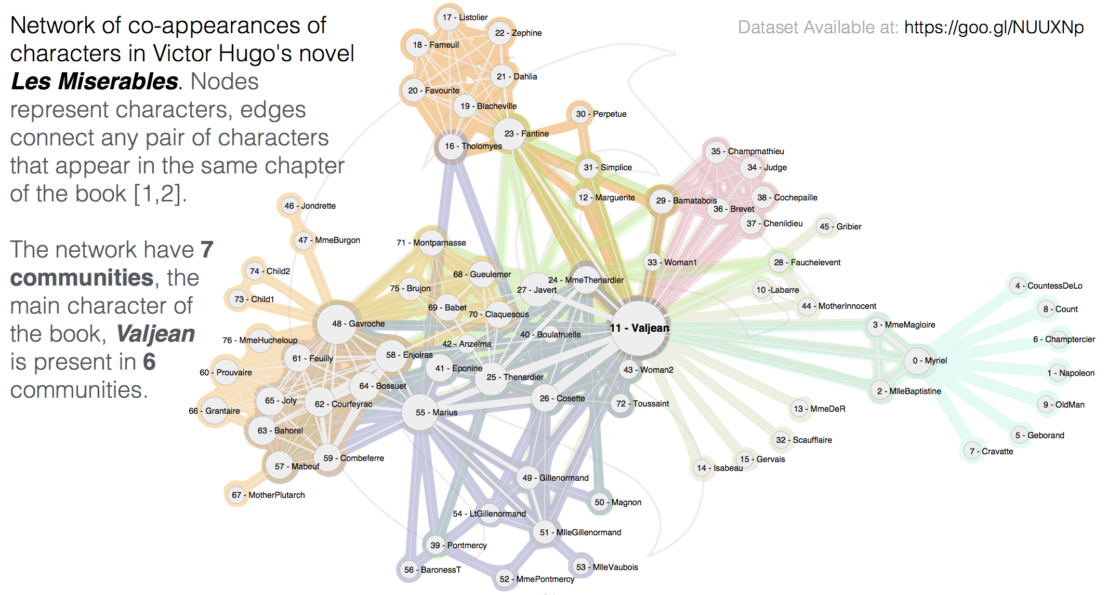
Another example – Les Miserables

Slide 23
THANKS
☺

